Slide 1
Session 14: the Java class library

Slide 2
The Java class library
Identity vs. Equality
Collections
Blue J chap. 6.1– 6.9

Slide 3
Recap
Loops
For-loops, While loops, For-each loops
Microexercise: Write a method that prints the 7 multiplication values for the number 7 (1 – 10)
Preferably, use a for-loop (or maybe a while)
for-each loops won’t work here if you solve this in a reasonable way
The output should be: 1*7=7, 2*7=14, 3*7=21... 10*7=17

Slide 4
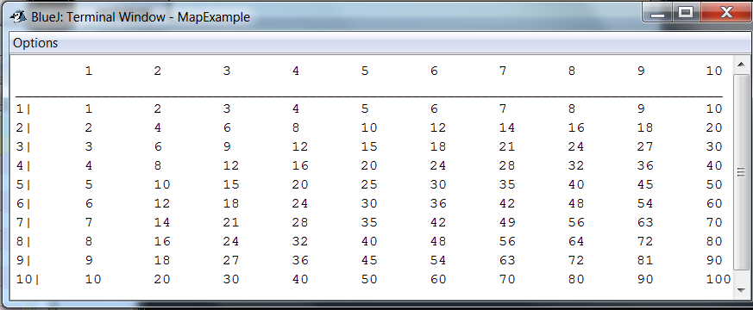
Recap
Microexercise: Use for-loops to print a 10x10 multiplicationtable!
Tip for formatting: “ \t” is the ‘magic’ character for the tabulator

Slide 6
The Java class library
Thousands of classes
Tens of thousands of methods
Many useful classes that make life much easier
A competent Java programmer must be able to work with the libraries.

Slide 7
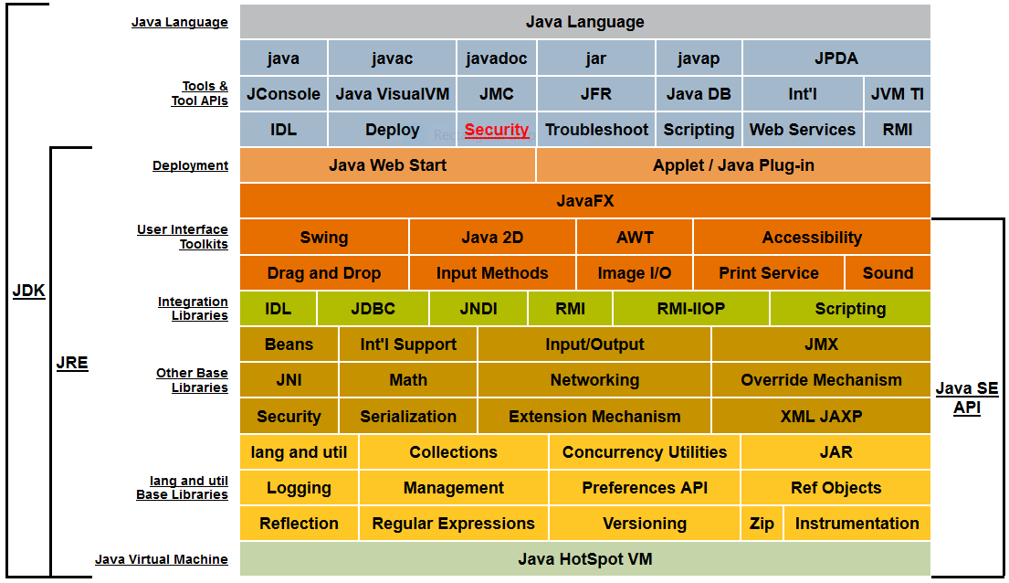
Take a look at the Java API
https://docs.oracle.com/javase/7/docs/

Slide 8
Working with the library
You should:
know some important classes by name;
know how to learn about classes.
Remember:
We only need to know the interface, not the implementation.

Slide 9
A Technical Support System
A textual dialog system
Idea based on ‘Eliza’ by Joseph Weizenbaum (MIT, 1960s)
System mimics technical support responses for a fictious company
Explore…

Slide 10
Main loop structure
boolean finished = false;
while(!finished) {
do something
if(exit condition) {
finished = true;
}
else {
<do something more>
}
}

Slide 11
Main loop body
Where does ‘startsWith()’ come from?
What is it and what does it do?
How can we find out?
String input = reader.getInput();
...
String response = responder.generateResponse();
System.out.println(response);
String input = reader.getInput();
if(input.startsWith("bye"))
finished = true;

Slide 12
Finding documentation
Choose the ”Java Class Libraries” item from BlueJ Help menu.
Documentation of the Java libraries in HTML format
Class API: Application Programmers’ Interface
Interface description for all library classes

Slide 13
Interface vs implementation
The documentation includes
the name of the class;
a general description of the class;
a list of constructors and methods
return values and parameters for constructors and methods
a description of the purpose of each constructor and method
the interface of the class

Slide 14
Interface vs implementation
The documentation does not include
private fields (most fields are private)
private methods
the bodies (source code) for each method
the implementation of the class

Slide 15
Using library classes
Classes from the library must be imported using an import statement (except classes from java.lang).
They can then be used like classes from the current package.

Slide 16
Packages and import
Classes are organised in packages.
Single classes may be imported:
Whole packages can be imported:
import java.util.ArrayList;
import java.util.*;

Slide 17
Review
Java has an extensive class library.
A good programmer must be familiar with the library.
The documentation tells us what we need to know to use a class (interface).

Slide 18
Exercise
Explore the JavaDoc for ArrayList

Slide 19




Meet Joe, Joe, and Joe

Slide 20
Identity vs Equality
For primitive data types
’==’ and ’!=’ tests equality (is it the same content?)
For reference types (i.e., objects)
’==’ and ’!=’ tests identity (is it the same object?)
In other words, they test if the references indicate the same address
For equality of objects: use the equals(…) method

Slide 21
Identity vs Equality 1
:Person
:Person
“Fred”
“Jill”
person1
person2
False
person1 == person2 ?
Notes:
== is not true here (of course)

Slide 22
Identity vs Equality 2
:Person
:Person
“Fred”
“Fred”
person1
person2
False
person1 == person2 ?
Notes:
== is still not true here (different objects, == tests identity)

Slide 23
Identity vs Equality 3
:Person
:Person
“Fred”
“Fred”
person1
person2
True
person1 == person2 ?
Notes:
== is true now (same object)

Slide 24
Identity vs Equality (Strings)
Gotcha: Interning!
String s1 = ”Joe”;
String s2 = ”Joe”;
if(s1==s2) {…}
It’s an artifact from from the JVM implementation – can’t be relied on
String input = reader.getInput();
if(input == "bye") {
...
}
:String
:String
==
?
"bye"
"bye"
input
False
Notes:
== is still not true here (different objects, == tests identity)

Slide 25
Identity vs Equality (Strings)
String input = reader.getInput();
if(input.equals("bye")) {
...
}
:String
:String
equals
?
"bye"
"bye"
input
true!

Slide 26




Identity & Equality
Joe, Joe, and Joe
are not identical
(identiske)
!=
!=
Joe, Joe, and Joe
are equal
(ens)
.equals( )

Slide 27

Joe and Bud
are identical.
They refer to
one and the same
person
==
Joe
Bud
Bud Spencer is the actor who plays Banana Joe

Slide 28
Sets
Sets are collections similar to ArrayLists
Sets do not maintain any order
Sets ensure that each element exists only once

Slide 29
Sets
Sets are collections similar to ArrayLists
Sets do not maintain any order
Sets ensure that each element exist only once
list
0 | 1 | 2 | 3 | 4

Slide 30
Sets
Sets are collections similar to ArrayLists
Sets do not maintain any order
Sets ensure that each element exist only once
set

Slide 31
Sets vs. Lists
list
0 | 1 | 2 | 3 | 4
set

Slide 32
Using sets
import java.util.HashSet;
...
HashSet<String> mySet = new HashSet<String>();
mySet.add("one");
mySet.add("two");
mySet.add("three");
for(String element : mySet) {
do something with element
}

Slide 33
Exercise
Investigate the HashSet class in the library.
What are the methods to perform CR(U)D called?

Slide 34
Maps
Maps are collections that contain pairs of values.
Pairs consist of a key and a value.
Lookup works by supplying a key, and retrieving a value.
An example: a telephone book.

Slide 35
Using maps
HashMap <String, String> phoneBook =
new HashMap<String, String>();
phoneBook.put("Charles Nguyen", "(531) 9392 4587");
phoneBook.put("Lisa Jones", "(402) 4536 4674");
phoneBook.put("William H. Smith", "(998) 5488 0123");
String phoneNumber = phoneBook.get("Lisa Jones");
System.out.println(phoneNumber);
:HashMap
"Charles Nguyen"
"(531) 9392 4587"
"Lisa Jones"
"(402) 4536 4674"
"William H. Smith"
"(998) 5488 0123"
A map with Strings as keys and values

Slide 36
Using maps
Person p1 = new Person(“banana_joe.jpg”);
Person p2 = new Person(“cotton_eyed_joe.png”);
Person p3 = new Person(“joe_sixpack.jpeg”);
Person p4 = new Person(“arnold.jpg”);
HashMap<String, Person> map = new HashMap<>();
map.put(“Banana Joe”, p1);
map.put(“Bud Spencer”, p1); // OK, key is unique
map.put(“Cotton Eyed Joe”, p2);
map.put(“Sixpack”, p3);
map.put(“Sixpack”, p4); //-- p3 is forgotten for key “Sixpack”

Slide 37

Person p1 = new Person(“banana_joe.jpg”);
Person p2 = new Person(“cotton_eyed_joe.png”);
Person p3 = new Person(“joe_sixpack.jpeg”);
Person p4 = new Person(“arnold.jpg”);
HashMap<String, Person> map = new HashMap<>();
map.put(“Banana Joe”, p1);
map.put(“Bud Spencer”, p1);
map.put(“Cotton Eyed Joe”, p2);
map.put(“Sixpack”, p3);
map.put(“Sixpack”, p4);
map
“Banana Joe”
“Bud Spencer”
“Cotton Eyed Joe”
keySet
“Sixpack”

Slide 38
Exercise
Create a HashMap<String, String>
Add 3-4 name – phone number pairs
Look up the phone numbers for the names.
use code like map.get(”Joe”) to look up phone numbers.
Print the phone numbers to the console
Do not copy-paste. Solve the exercise in a structured way.

Slide 39
Using Random
The library class Random can be used to generate random numbers
import java.util.Random;
...
Random randomGenerator = new Random();
...
int index1 = randomGenerator.nextInt();
int index2 = randomGenerator.nextInt(100);

Slide 40
Generating random responses
public Responder() {
randomGenerator = new Random();
responses = new ArrayList<String>();
fillResponses();
}
public String generateResponse() {
int index = randomGenerator.nextInt(responses.size());
return responses.get(index);
}
public void fillResponses() {
...
}

Slide 41
Tokenising Strings
public HashSet<String> getInput() {
System.out.print("> ");
String inputLine = reader.nextLine().trim().toLowerCase();
String[] wordArray = inputLine.split(" ");
HashSet<String> words = new HashSet<String>();
for(String word : wordArray) {
words.add(word);
}
return words;
}

Slide 42
Exercises
BlueJ ex. 6.2 - 6.33
6.2 – 6.11 investigating the String class
6.12 – 6.22 investigating the Random class
6.25 - 6.33 investigating the HashMap class
Extra: Write a program that can generate lotto numbers suggestions.
Euro Jackpot: 5/50 + 2/10 Star numbers
Wednesday Lotto (Onsdagslotto): 6/48
Saturday Lotto: 7/36

